Slide 1
Corporate Overview
Initial Public Offering
July 2021
Issuer Free Writing Prospectus
Filed Pursuant to Rule 433
Registration No. 333-257688

Slide 2
Cautionary Statements
This presentation has been prepared by DatChat, Inc. (the “Company”) solely for informational purposes based on its own information, as well as information from public sources. This presentation has been prepared to assist interested parties in making their own evaluation of the Company and does not propose to contain all of the information that may be relevant. In all cases, interested parties should conduct their own investigation and analysis of the Company and the data set forth in the presentation and any other information provided by or on behalf of the Company. This presentation does not constitute an offer to sell, nor a solicitation of an offer to buy, any securities of the Company by any person in any jurisdiction in which it is unlawful for such person to make such an offering or solicitation. Neither the Securities and Exchange Commission nor any other regulatory body has approved or disapproved of the securities of the Company or passed upon the accuracy or adequacy of this presentation. Any representation to the contrary is a criminal offense.
Except as otherwise indicated, this presentation speaks as of the date hereof. The delivery of this presentation shall not, under any circumstances, create any implication that there has been no change in the affairs of the Company after the date hereof.
Certain of the information contained herein may be derived from information provided by industry sources. The Company believes that such information is accurate and that the sources from which it has been obtained are reliable. The Company cannot guarantee the accuracy of such information and has not independently verified such information.
This presentation contains forward-looking statements within the meaning of the federal securities laws. These forward-looking statements can be identified by the use of forward-looking terminology, including the terms “believe,” “estimate,” “project,” “anticipate,” “expect,” “seek,” “predict,” “continue,” “possible,” “intend,” “may,” “might,” “will,” “could,” would” or “should” or, in each case, their negative, or other variations or comparable terminology. These forward-looking statements include all matters that are not historical facts. They appear in a number of places throughout this presentation and include statements regarding our intentions, beliefs or current expectations concerning, among other things, our product candidates, clinical development pathway, research, commercialization objectives, prospects, strategies and the industry in which we operate. We derive many of our forward-looking statements from our operating budgets and forecasts, which are based upon many detailed assumptions. While we believe that our assumptions are reasonable, we caution that it is very difficult to predict the impact of known factors, and, of course, it is impossible for us to anticipate all factors that could affect our actual results. Forward-looking statements should not be read as a guarantee of future performance or results and may not be accurate indications of when such performance or results will be achieved. In light of these risks and uncertainties, the forward-looking events and circumstances discussed in this presentation may not occur and actual results could differ materially from those anticipated or implied in the forward-looking statements. A number of important factors could cause our actual results to differ materially from those indicated in these forward-looking statements, including the following: risk factors described under the heading “Risk Factors” in the Company’s registration statement on Form S-1, filed with the Securities and Exchange Commission (File No. 333-257688).
The issuer has filed a registration statement on Form S-1 (including a prospectus), which is preliminary and subject to completion, with the Securities and Exchange Commission for the offering to which this presentation relates. Before you invest, you should read the prospectus in that registration statement and the other documents that the issuer has filed with the Securities and Exchange Commission carefully and in their entirety for more complete information about the issuer and this offering. You may obtain these documents for free by visiting EDGAR on the SEC website at www.sec.gov. Alternatively, the issuer, or any underwriter or dealer participating in the offering, will arrange to send you the prospectus if you request it by contacting EF Hutton, division of Benchmark Investments, LLC by email at syndicate@efhuttongroup.com, or by telephone at (212) 404-7002.

Slide 3
Offering Summary
Issuer: | DatChat, Inc.
Proposed Tickers / Exchange: | DATS, DATSW / Nasdaq Capital Market
Offering Type: | Firm Commitment Underwritten Initial Public Offering
Securities Issued: | Common Stock and Warrants
Gross Offering Proceeds: | Up to $14.7 million
Over-Allotment: | 15%
Estimated Offering Price Range: | $4.15 - $5.15 per share of common stock and accompanying warrant
Pre-Money Shares Outstanding: | 13.4 million*
Anticipated Use of Proceeds: | Product development, marketing and working capital and general corporate purposes
Book-Running Managers: | EF Hutton, division of Benchmark Investments, LLC; US Tiger Securities, Inc.
Expected Close: | Q3 2021
*1-for-2 reverse stock split as of July 28, 2021
Source: Company filing data

Slide 4
Investment Highlights
One of the first encrypted social and messaging platform
Management and development team with extensive experience in application based technologies
Advantages of Blockchain to create a trusted and reliable network
Proprietary technology
Easy to scale and manage the DatChat platform for a large user base
Fast growing cyber security and privacy industry expected to reach $190 billion per year by 2028¹
1. Source: Grandview Research, Inc.

Slide 5
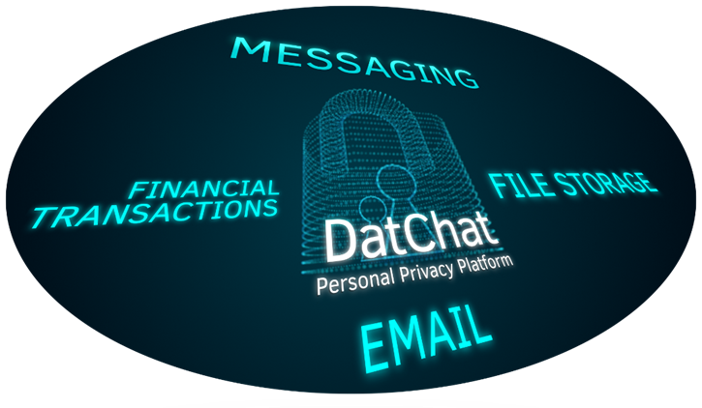
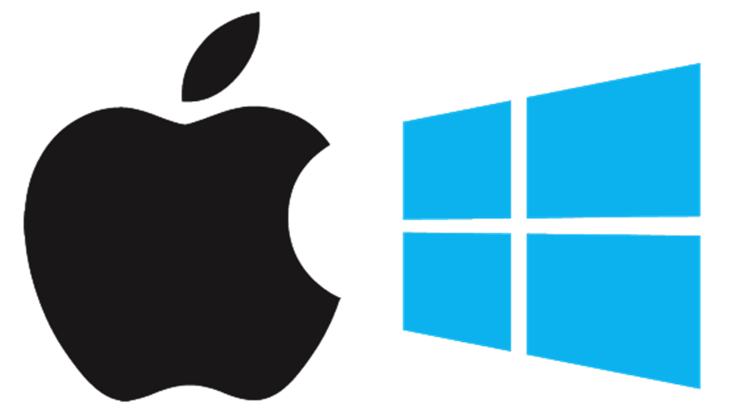
Recent and Upcoming Milestones
Launched app store marketing for iOS & Google Play Stores
Launch online dating marketing campaign
New monetization of DatChat via in-app purchases
Q4 2021
Sept. 2021
Aug. 2021
Launch paid desktop versions for Windows and Mac
May 2021
Launch world’s first communication based Blockchain for consumers and enterprise clients
Launch social media influencer campaign and public relations campaign

Slide 6
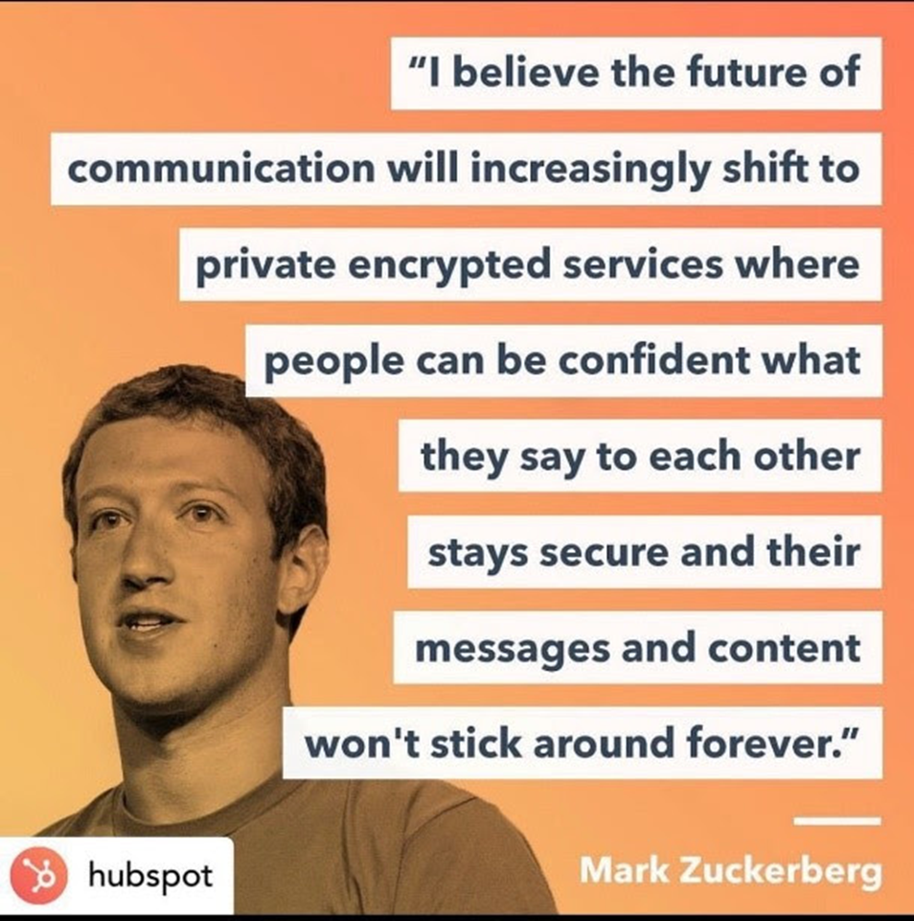
About DatChat
Currently, social media & messaging are creating new privacy & security risks for businesses, civilian & military agencies
Users have a right to privacy, both in real life and on social media
Proprietary cyber-security & Blockchain technology* that focuses on security risks that are created by both external and internal social media & messaging
Patented encryption technology allows users and administrators to control information after it has been shared or posted
*DatChat’s Blockchain technology is not associated with cryptocurrency

Slide 7
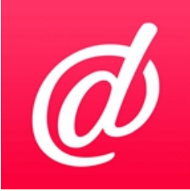
Flagship Product: DatChat Messenger
DatChat Messenger, with advanced privacy controls for users engaged in both individual and group messaging, provides its users enhanced control over their messages before and after they are sent
Extensive User Ability to Limit Message Availability to Recipients
Users can control the amount of views or time a message they send is available to the recipient or recipients in a group message
User Control over Sent Messages
Users may unilaterally delete messages off a recipient’s device
Users may also unilaterally delete or “Nuke” entire conversations off a recipient’s device
Anti-Screenshot Protection
DatChat Messenger utilizes patent pending technology to give users who send messages the option to limit the recipient’s ability to screenshot and save the contents of the message
If a recipient can take a screenshot, it comes in as a blank image, the sender is notified, and the post automatically disappears for that user
Message Encryption
Messages sent via DatChat Messenger are encrypted with AES256, and RSA is utilized for sending the key to open the message

Slide 8
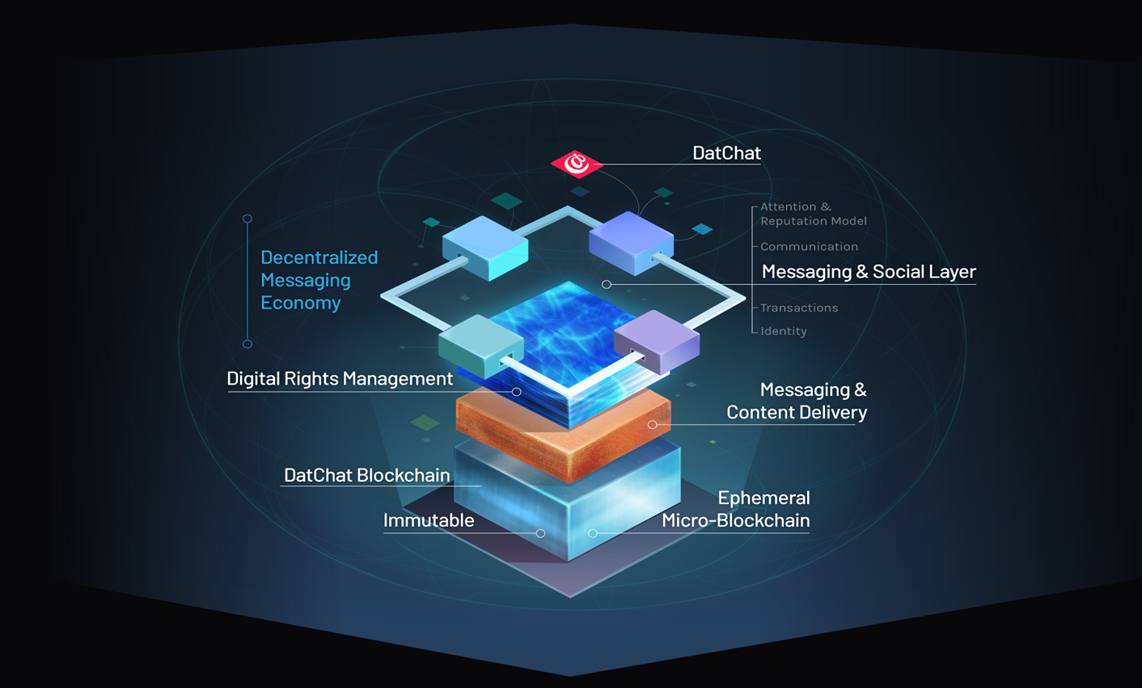
Innovating Blockchain for Social & Messaging Applications
Proprietary Technology focused on Personal Privacy, Security, Communication & Digital Rights Management
Developing a Micro-Blockchain to create trusted and reliable peer-to-peer connections
DatChat Micro-Blockchain ensures trust that you are connecting to the right user
Ensures the security of those connections
Reliability that data is delivered when and where it is supposed to be
Multi-tiered encryption options
Additional Micro-Blockchain uses: personal social networks, private message boards, family archive, photo sharing, document sharing

Slide 9
Enterprise Technology Advantages
User
Full control after hitting send, submit, or post
Messages only last as long as you allow with self-destruct mode
Prevent screenshots
Easy to use and scalable
Patented technology to allow forwarding with permission upon request
Create private & encrypted social networks
Administrator
Full control of posts and messages after being sent
Robust archiving
Ability to screenshot user content
Closed encrypted environment w/ admin permissions
Ability to adjust encryption levels for user groups
Encrypted messaging and notifications broadcasting for all users

Slide 10
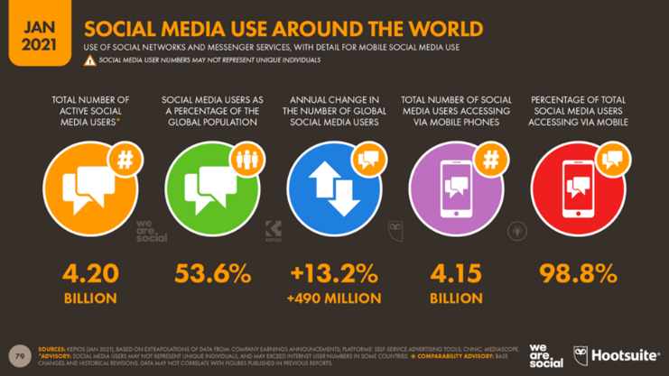
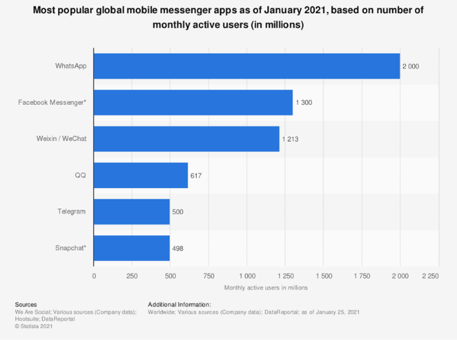
Industry Opportunity
Recent controversy surrounding censorship is creating a unique opportunity for DatChat to grow exponentially
In addition to the 1.3 million new social media users a day across all platforms, a large portion of the 4.2 billion existing users and 2.7 billion messenger app users are now up for grabs¹
Creating a safe space for privacy creates a place where we can chat and share with our friends the way we do face-to-face, in real life
In a time when you can lose your job for liking the wrong meme, DatChat protects our privacy and data protection rights
1. Source: eMarketer

Slide 11
Capitalization, Use of Proceeds, and Marketing Plan
Target ~4.2 billion existing social media users across all existing social media platforms
Use key social influencer (non-celebrity) bloggers and podcasters that are relevant to privacy and cyber-security
Aggressive platform & corporate PR campaign to build awareness
In-app purchases to activate personalization features
Subscription-based enterprise product
Total (100%)

Slide 12
Competitor Analysis
DatChat’s competitive advantages far surpass the multiple patents it holds, encompassing the spectrum of end-to-end encrypted messaging, complete message control after send, anti-forwarding technology, and screenshot protection
The real value is in how it developed the technology to adapt to everyday personal and business life
DatChat’s robust yet simple privacy and social features make its application both seamless and intuitive
Company | Always Encrypted | Prevent Screenshots | Encrypted Group Chat | Self-Destruct or Add time | Nuke Feature | Message Viewed Report | Prevent Message Forwarding | Private Encrypted Social Network
DatChat | Yes | Yes | Yes | Yes | Yes | Private | Yes | Yes, First Private & Encrypted Social Network
Signal | Yes | No | Yes | No | No | Private | No | No
Telegram | No | No | No | No | No | Private | No | No
WhatsApp | Yes | No | Yes | No | No | Private | No | No
Snap | No | No | No | No | No | Private | No | No
MeWe | No | No | No | No | No | Public | No | No

Slide 13
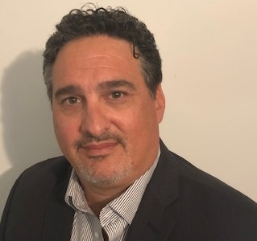
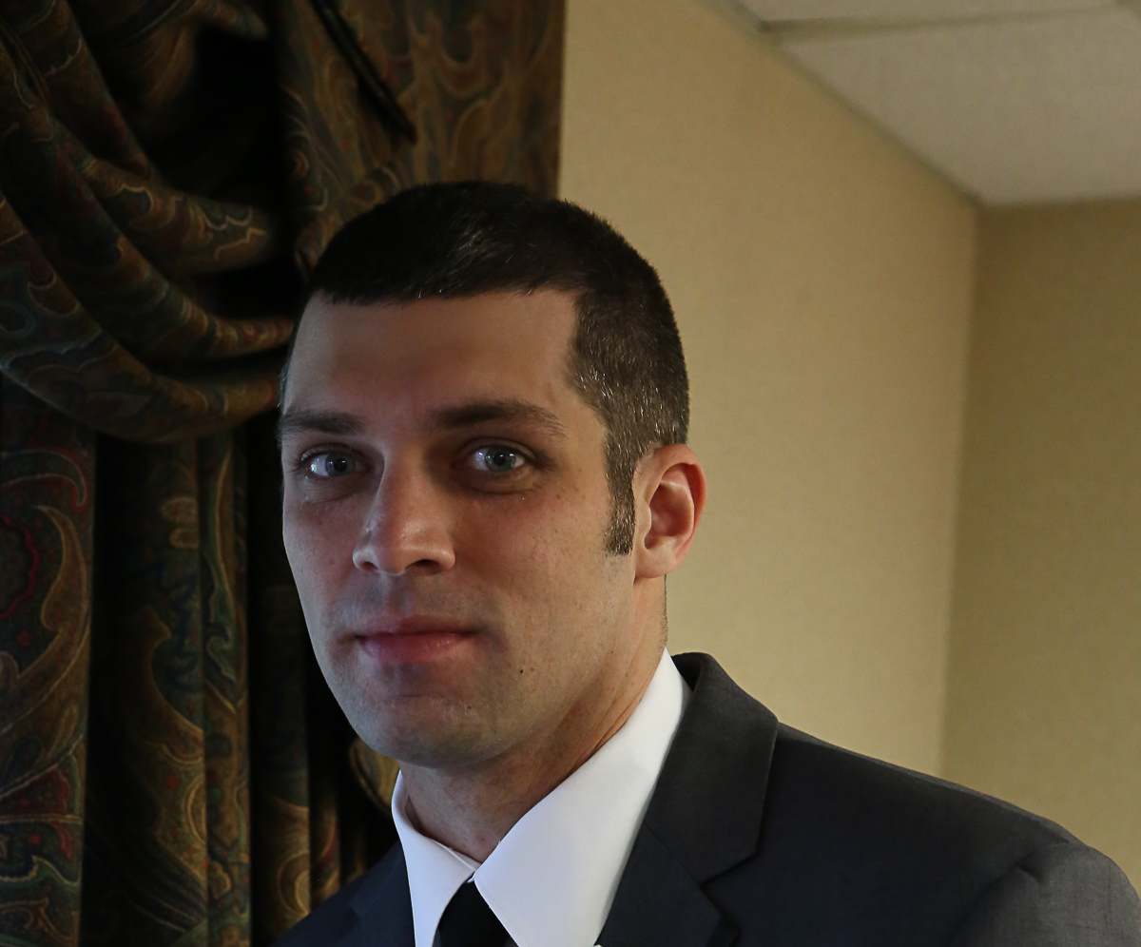
Management Team
Darin Myman
Chief Executive Officer
Peter Shelus
Chief Technology Officer
Gabriel Daniels
Chief Information Officer
Co-founder and has served as CEO since 2016
Previous CEO of Wally World Media, Inc.
Served as CEO and a member of PeopleString’s Board of Directors since its inception.
Founded, conceptualized and patented self-destruction email for Bigstring Corp.
Has extensive executive management and board experience having served as a co-founder CEO, and board director of BigString Corporation since 2005
Co-founder and CEO of LiveInsurance.com
Co-founder and has served as CTO since 2016
Over 10 years of ephemeral messaging and mobile video development experience
Pioneer and thought leader in secure messaging having developed patented technology that became a cornerstone of self-destructing messaging
Graduate of Rutgers University with honors and a degree in Computer Science
15years, Military (Navy & Army) Veteran, professor and cybersecurity expert
Mr. Daniels has high-level mission critical, cyber experience working with agencies within the U.S. intelligence community, NATO, Department of Defense, and Department of Treasury.
CASP, CEH, CND-A, CCNA-Security, Security +, ITIL, SAFe
Mr. Daniels holds a master’s degree in cybersecurity and a bachelor’s degree in marketing from the University of Maryland University College and currently working on his Doctorate in cybersecurity.

Slide 14
THANK YOU
Darin Myman
Chief Executive Officer
dmyman@datchats.com
Benjamin Zucker
EF Hutton
bzucker@efhuttongroup.com

